Slide 1
Complex Pricing
Indirect Price Discrimination
Management 405
Prof. Paola Giuliano · UCLA Anderson

Slide 2
Complex Pricing · Roadmap
Outline
1
Simple and complex pricing
The pricing dilemma and why complex pricing pays
2
Direct price discrimination
First-degree (perfect) and third-degree (segment) pricing
3
Indirect price discrimination
Versioning and coupons (second degree)
4
Advanced pricing strategies
Volume/flat-fee, two-part tariff, block pricing
5
Auctions
Competitive bidding and auction formats
Management 405 · Complex Pricing
2

Slide 3
Complex Pricing · Indirect Price Discrimination
Second-Degree Price Discrimination — Versioning
Indirect price discrimination
Charge a different price for different versions of the product
Conditions:
  Heterogeneous consumers
  Firm has market power and can prevent resale
  Firm cannot identify groups of consumers with different price sensitivities
Management 405 · Complex Pricing
3

Slide 4
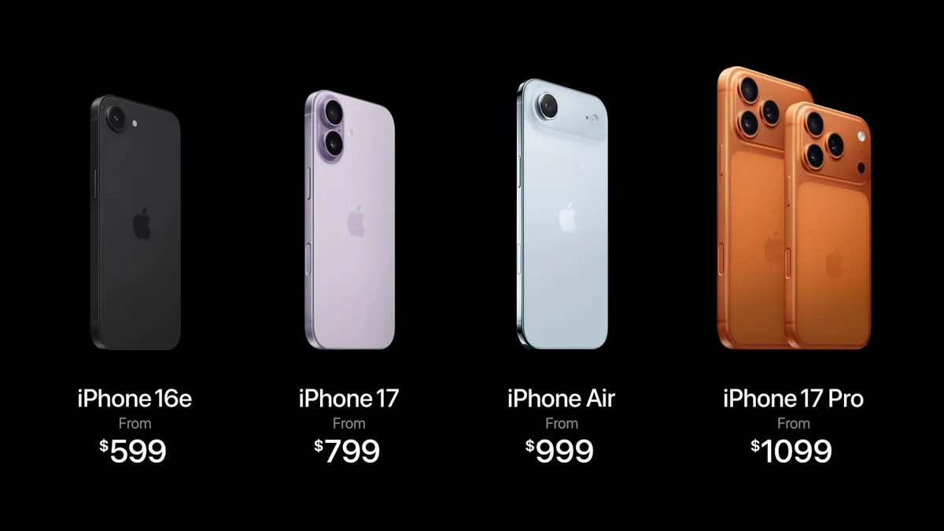
Complex Pricing · Indirect Price Discrimination
Versioning
P
Version 1
P₁
Version 2
P₂
Version 3
P₃
Create different “versions” of your product
Design them so customers with different WTP “self-select” into the desired version
Version 4
P₄
Version 5
P₅
demand
Management 405 · Complex Pricing
4

Slide 5
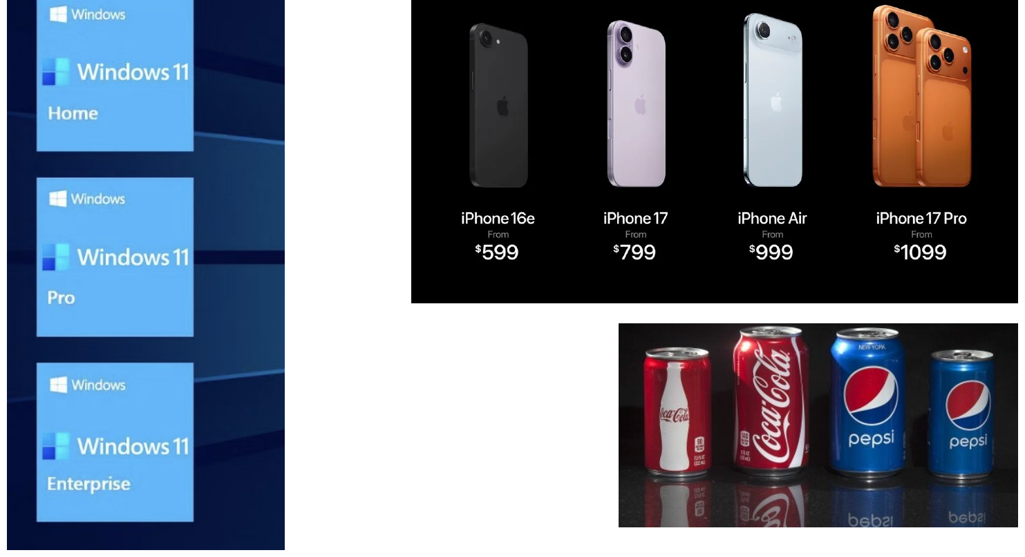
Complex Pricing · Indirect Price Discrimination
Versioning: Product Lines
Offer a product line and let users sort themselves
Management 405 · Complex Pricing
5
Notes:
An example of Second Degree Price Discrimination: Versioning
We will go in greater depth into one form of second degree price discrimination which is versioning. Versioning is incentive compatible and accomplishes everything that price discrimination accomplishes. Consumers who buy at a high price do so willingly. The key to understand this is that the version priced at a premium has to have features that generate some value to the consumer, but the cost differential to the company is minor relative to the price differential (otherwise there is no real discrimination on price if the surplus captured is the same across segments).
The perfect example is Microsoft: offers Windows Professional and Windows Home Edition. Windows Pro has more features than Home edition but they are otherwise close substitutes. The marginal cost of producing each is identical (and approximately zero) – in fact it may cost the company something to actually differentiate the products. Sometimes it costs nothing to make something better but you don’t want to do it: why doesn’t Microsoft offer the full version of Windows to all their customers since the MC of doing so is zero? Because they would then join the markets, and forego the benefits of price discrimination. You add features to the price insensitive segment so you can charge them more.

Slide 6
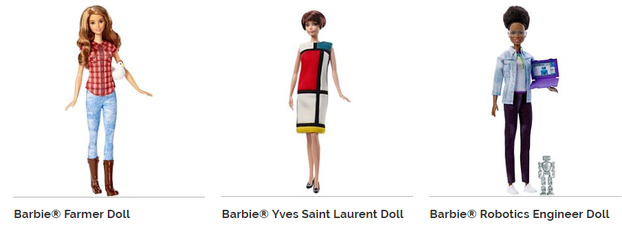



Complex Pricing · Indirect Price Discrimination
Versioning: Dolls
Management 405 · Complex Pricing
6

Slide 7
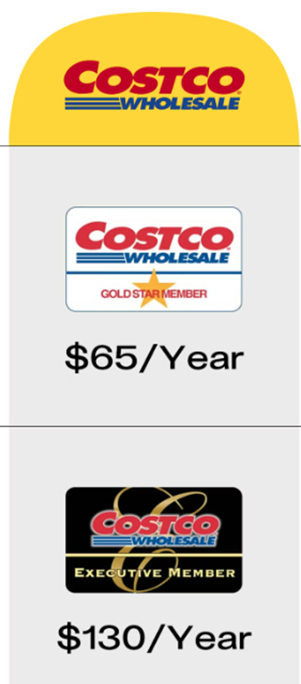
Complex Pricing · Indirect Price Discrimination
Versioning: Costco
Business model
  Make money on the memberships
  Sell goods at the cheapest price possible
Management 405 · Complex Pricing
7
Notes:
https://www.wsj.com/business/retail/costco-kirkland-signature-pants-lululemon-792becb2?mod=wknd_pos1

Slide 8
Complex Pricing · Indirect Price Discrimination
More Examples of Versioning
Internet service: higher speed at a higher price
FedEx / UPS: 2nd-day vs. same-day delivery
iPhone and BMW product lines
Tinder Plus and Gold
Airlines (Air Canada, Toronto–Calgary):
  $180 “Tango”, $338 “Fun”, $554 “Latitude”, $995 “Freedom”, $1,024 “Executive Class”
Important: keep the low-quality option inferior enough to prevent premium customers being tempted
  FedEx reportedly “delays” 2nd-day delivery on purpose
Management 405 · Complex Pricing
8

Slide 9
Complex Pricing · Roadmap
Outline of Module 6
1
Simple and complex pricing
The pricing dilemma and why complex pricing pays
2
Direct price discrimination
First-degree (perfect) and third-degree (segment) pricing
3
Indirect price discrimination
Versioning and coupons (second degree)
4
Advanced pricing strategies
Volume/flat-fee, two-part tariff, block pricing
5
Auctions
Competitive bidding and auction formats
Management 405 · Complex Pricing
9

Slide 10

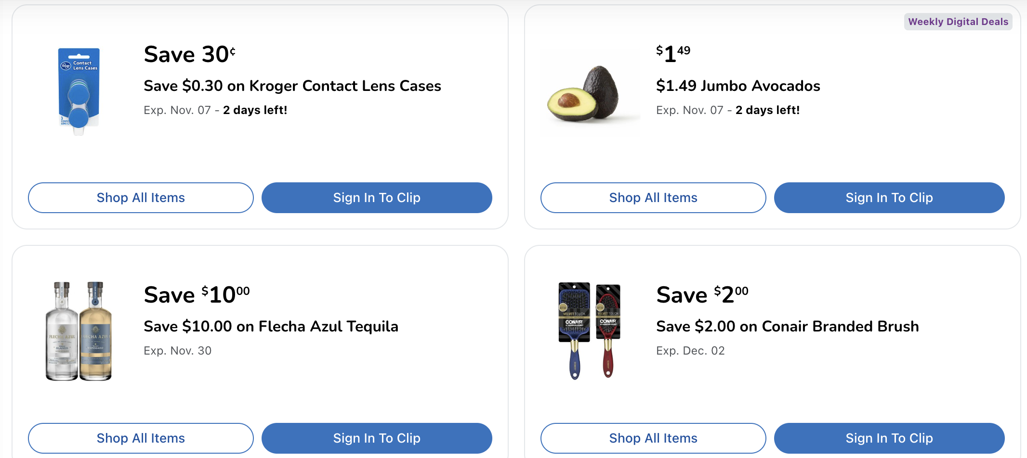
Complex Pricing · Indirect Price Discrimination
Second-Degree Price Discrimination: Coupons
Management 405 · Complex Pricing
10
Notes:
Checkout stand coupons: Nobody wants to spend money unnecessarily, but it takes time to sort through the coupons. Those who have nothing else to do on a Sunday morning, i.e. those with a low opportunity cost of time, who are price sensitive, will take the time to cut the coupons. This is an ingenious scheme to charge higher price to the low elasticity customers to capture more consumer surplus.
Another Example: Fun Film sold at Price Costco. This is a classic example. Kodak was selling their premium Royal Gold film. Fuji and others started competing. Kodak wanted to protect the low end of their market. They could have lowered the price on Royal Gold, but then you give up capturing the surplus at the high end. So they introduced a new brand, FunFilm, offered only at discount stores like Sam’s Club, Costco, in bulk. This is where price sensitive customers go. It turns out the two films were chemically identical. The packaging and bulk sales aspect were different but the actual product was the same. This is a classic B-school case.

Slide 11
Complex Pricing · Roadmap
Outline
1
Simple and complex pricing
The pricing dilemma and why complex pricing pays
2
Direct price discrimination
First-degree (perfect) and third-degree (segment) pricing
3
Indirect price discrimination
Versioning and coupons (second degree)
4
Advanced pricing strategies
Volume/flat-fee, two-part tariff, block pricing
5
Auctions
Competitive bidding and auction formats
Management 405 · Complex Pricing
11

Slide 12
Complex Pricing · Advanced Pricing
Volume Pricing
How to extract consumer surplus from a consumer prepared to buy multiple units
Diminishing marginal personal value comes into play
We will study two variants of volume pricing:
  All-or-none offers (flat fee)
  Two-part pricing strategies (fixed fee + usage fee)
Management 405 · Complex Pricing
12

Slide 13

Complex Pricing · Advanced Pricing
Example: Netflix — Simple Pricing (assume MC = 0)
P
Could Netflix do better than simple price?
P = 2 − Q/8
$2
MR
$1
Revenues =$8
D
8
16
Movies
Management 405 · Complex Pricing
13
Notes:
Xxx Draw CS and ask to compute
When an individual can buy several units of an item, the seller can think about a volume pricing strategy. This is the case of continuous choice as opposed to binary choice (buy/don’t buy). Diminishing marginal personal value comes into play – the value of each subsequent unit falls.
We will talk about 3 kinds of volume pricing; we will see examples of each - they all amount to the same thing:
— Fixed fee + access price
— All or nothing pricing: bundle.
— Quantity discounts: sliding scale.
Examples of volume pricing:
— Rockreation: fixed monthly fee, unlimited access. Also, price differences with SLC. Is it price discrimination (probably, no – may reflect cost differentials, especially rent)
— Health Club: Annual fee
— Car Wash: Fixed fee - unlimited washes
— Netflix: Monthly fee – “unlimited” rentals
Analytics will help to clarify all this here. We still abstract from cost and set MC=0. The optimal price is where Q=10 because the slope of MR is twice the slope of D and we are setting MR=0. Under simple pricing, there is unexploited volume equal to the lower triangle ($100 of value) and the consumer retains a surplus of $100. The company ends up with revenues of $200. There is some opportunity to do some business here.

Slide 14
Complex Pricing · Advanced Pricing
Example: Netflix — Volume Pricing: Flat Fee (MC = 0)
P
Yellow area = total value of unlimited movies = max fee Netflix can charge
Area = (16 × 2)/2 = 16
A $16 flat fee for unlimited access → $16 revenue
The consumer watches 16 movies
Consumer surplus = 0
Only makes sense when MC = 0
P = 2 − Q/8
$2
Revenues =$16
D
16
Movies
Management 405 · Complex Pricing
14
Notes:
With MC=0, people buy to where the value is zero. You want to capture the entire area under the demand curve. How much does the consumer pay? For a flat fee of $400, he would be just willing to purchase the bundle of 20 units. The company doubles their contribution and extracts all the surplus.
Equivalent pricing schemes: A sliding scale discount pricing scheme amounts to the same thing – charge lower and lower amounts for each subsequent unit sold. Here you march the consumer down the demand curve and you charge successively lower prices that allow you to capture all the surplus. The quantity discounts come from the seller’s realization that the buyer has a downward sloping demand curve.

Slide 15
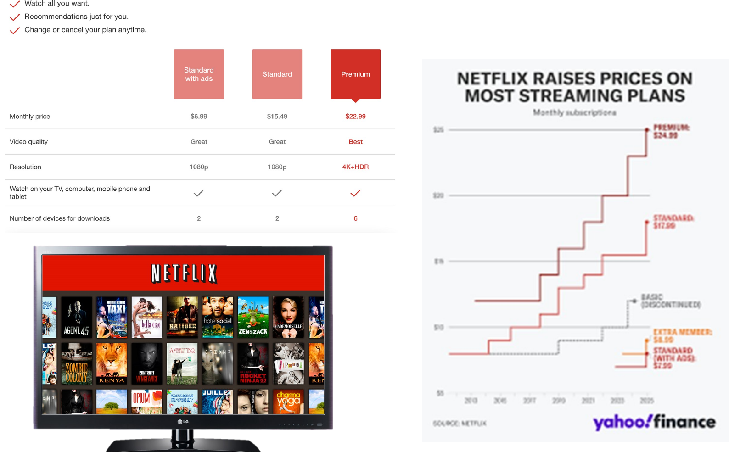
Complex Pricing · Advanced Pricing
Netflix Pricing Strategy
▶ Watch: Netflix price hikes & subscriber growth (Yahoo Finance)
Management 405 · Complex Pricing
15
Notes:
This chart represent the pricing strategy of Netflix, as an example of versioning. They have three plans, from basic to premium. The chart on the right represents the change in strategy that Netflix followed over time
This is a very good video on increase in price in 2017, where they also discuss previous price increases and the backlash associated with them
https://finance.yahoo.com/news/netflix-price-hikes-wont-hurt-subscriber-growth-211526185.html

Slide 16
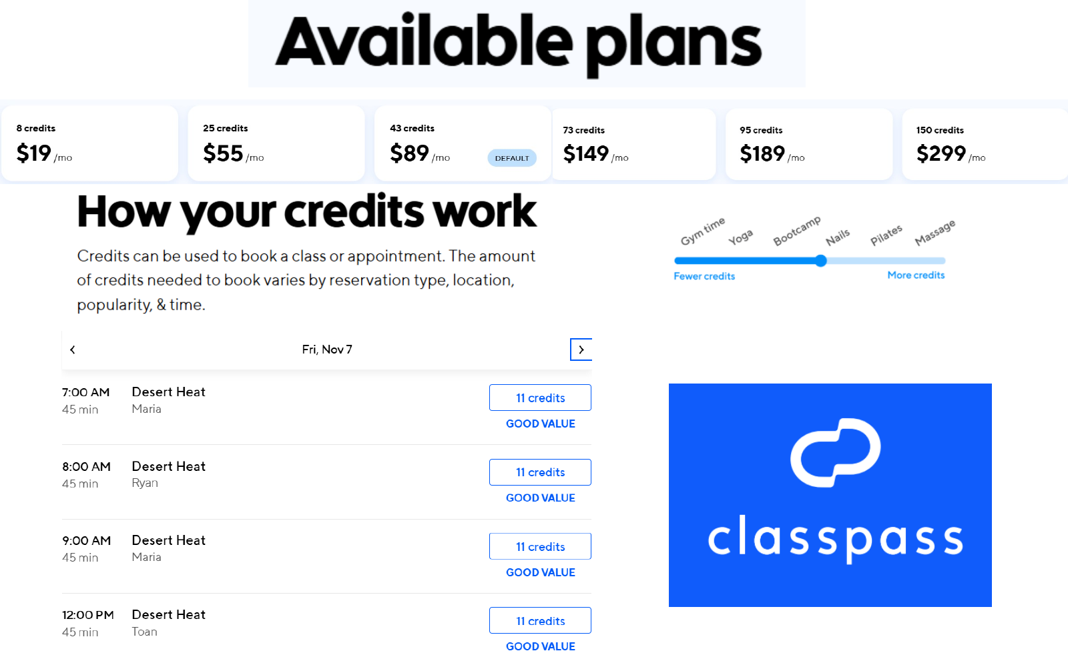
Complex Pricing · Advanced Pricing
ClassPass Pricing Strategy
Management 405 · Complex Pricing
16
Notes:
I introduced class pass because the founders are women. Also they have an interesting pricing strategy. Members can buy their plans based on how many credits they want to spend per month, but also the number of credit per class varies, popular classes are worth 9 credit, less popular ones only 2. Credits also change based on time of the day.

Slide 17
Complex Pricing · Roadmap
Outline of Module 6
1
Simple and complex pricing
The pricing dilemma and why complex pricing pays
2
Direct price discrimination
First-degree (perfect) and third-degree (segment) pricing
3
Indirect price discrimination
Versioning and coupons (second degree)
4
Advanced pricing strategies
Volume/flat-fee, two-part tariff, block pricing
5
Auctions
Competitive bidding and auction formats
Management 405 · Complex Pricing
17

Slide 18
Complex Pricing · Advanced Pricing
Two-Part Tariff
Set a flat fee (T) and a usage fee (P)
  Video game systems: console (fixed fee), games (per-unit price)
  Zipcar: annual membership (fixed fee), hourly rental (per-unit price)
  Amazon Prime: yearly charge (fixed fee), purchases (per-unit price)
Set the usage fee P* = MC
  Avoids excessive use
Set the flat fee T* = entire consumer surplus = (Pmax − P*)·Q / 2
  Q is where MC intersects D — plug P* into the demand equation
Management 405 · Complex Pricing
18

Slide 19
Complex Pricing · Advanced Pricing
Two-Part Tariff
P
Flat fee T* = the entire consumer surplus
Usage fee P* = the marginal cost (MC)
T*
MC
P*
D
Q
Management 405 · Complex Pricing
19

Slide 20
Complex Pricing · Roadmap
Outline of Module 6
1
Simple and complex pricing
The pricing dilemma and why complex pricing pays
2
Direct price discrimination
First-degree (perfect) and third-degree (segment) pricing
3
Indirect price discrimination
Versioning and coupons (second degree)
4
Advanced pricing strategies
Volume/flat-fee, two-part tariff, block pricing
5
Auctions
Competitive bidding and auction formats
Management 405 · Complex Pricing
20

Slide 21
Complex Pricing · Advanced Pricing
Block Pricing: Photo Cards at Walmart
Price
($/photo card)
▪ Block pricing is the practice of reducing the price of a good when the customers buys more of it.
▪ The company does not discriminate across customers with different demands
▪ The simple pricing option is 100 cards at $.025
▪ Producer surplus is A
▪ Sell additional 25 cards at $0.20
$0.25
▪ Consumers are better off, additional CS is area B
$0.20
B
▪ Walmart is also better off, additional PS is C
A
▪ Walmart could keep offering discounted prices
C
D
$0.10
E
MC
$0.05
MR
D
100
125
175
Q (photo cards)
Management 405 · Complex Pricing
21
Notes:
Note that the pricing strategy can be also be expressed as 100 at $25, 125 at $30, 175 at 35$. Consumers will opt to purchase 175 at $35 and wallmart will still increase its producer surplus

Slide 22
Complex Pricing · Summary
How to Extract Consumer Surplus — A Summary
Does the firm have market power?
No
Perfect competition produces quantity at which MR = P = MC
Yes
Can the firm prevent resale and arbitrage?
No
Firm produces Q* at which MR = MC, sets P* where Q* = D(P*)
Yes
Do the firm's customers have different demand curves?
Advanced pricing strategies: volume pricing (flat-fee), two-part tariff, block-pricing
No
Yes
Direct price discrimination
Can the firm directly identify customers' demands before purchase?
Indirect (second-degree) price discrimination: versioning, coupons
Yes
No
Complete information on every customer → Perfect (first-degree)
Information on groups of customers → Segmenting (third-degree)
Source: Goolsbee, Levitt, Syverson
Management 405 · Complex Pricing
22

Slide 23
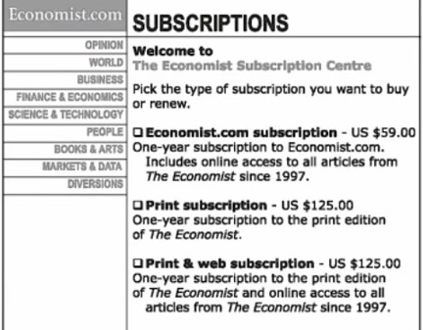
Complex Pricing · Behavioral Pricing
The Economist Pricing Example
What do you think about this pricing strategy?
Management 405 · Complex Pricing
23
Notes:
The experiment was as follows,
- In one case consumers saw two options at 125 one including only print and one including print and web, and one at $59.
- In the other treatment consumer were given two options: $59 and $125 for print and web.
When people saw the three options 84% of them chose print and web and only 16% the cheapest option. Their attention went to the comparison between the two options at 125.
In the experiment with two options only 32% of them chose the expensive option, most of the (68% chose the $59 option)

Slide 24
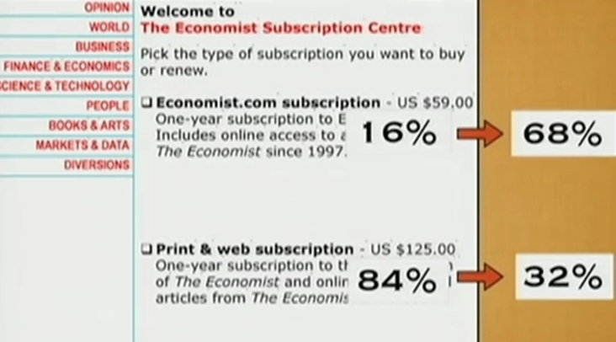
Complex Pricing · Behavioral Pricing
Dan Ariely’s Experiment
Management 405 · Complex Pricing
24

Slide 25
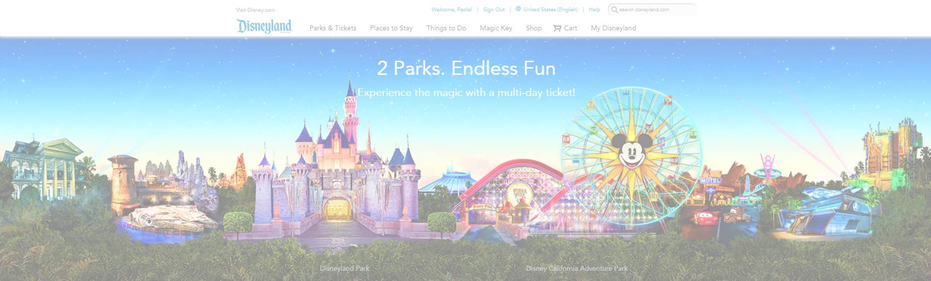
Complex Pricing · Case: Disneyland
Pricing Strategy
Explain Disneyland’s pricing strategy.
Group discussion break
Management 405 · Complex Pricing
25

Slide 26
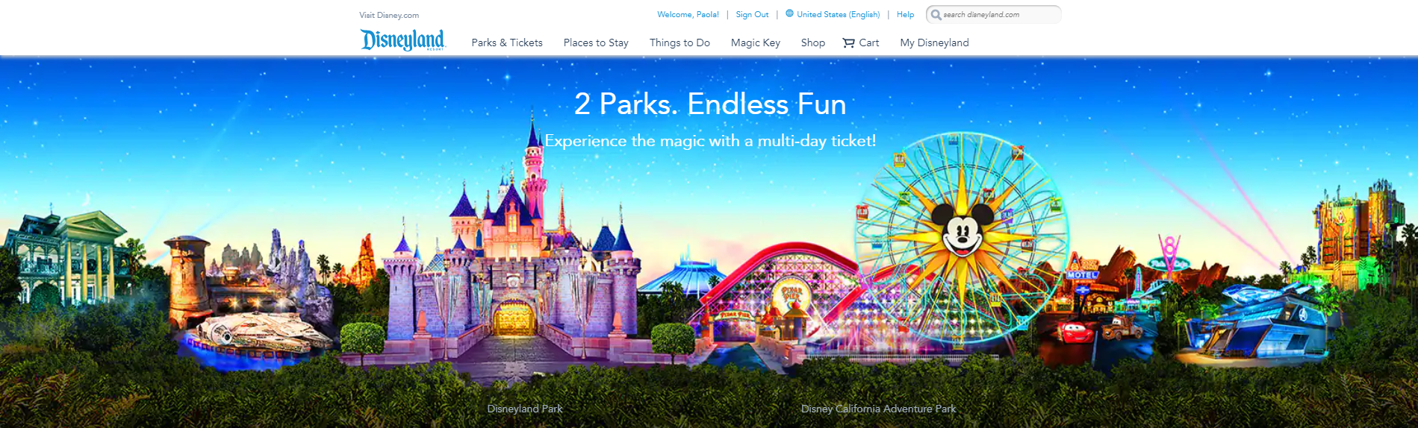
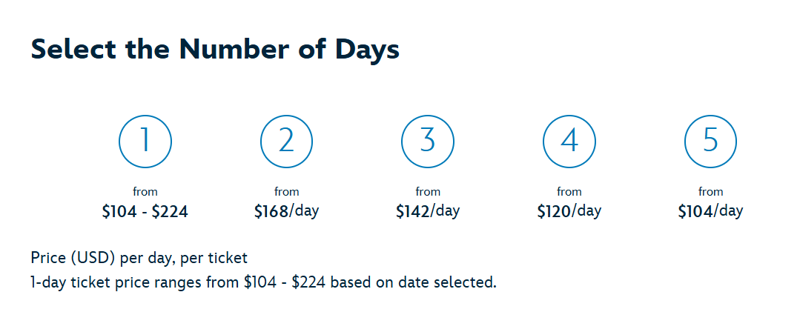
Complex Pricing · Case: Disneyland
Disneyland: 2nd-Degree Price Discrimination
Management 405 · Complex Pricing
26
Notes:
1 day variable from 104 to 179

Slide 27
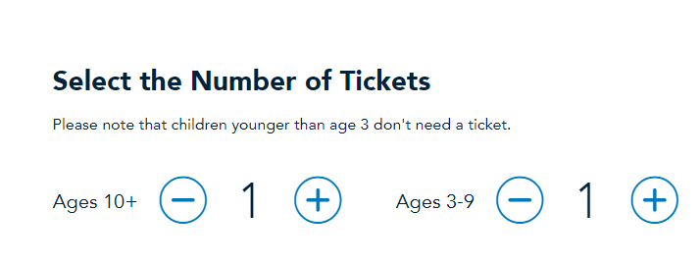
Complex Pricing · Case: Disneyland
Disneyland: 3rd-Degree Price Discrimination
Management 405 · Complex Pricing
27
Notes:
This chart represent the pricing strategy of Netflix, as an example of versioning. They have three plans, from basic to premium. The chart on the right represents the change in strategy that Netflix followed over time
This is a very good video on increase in price in 2017, where they also discuss previous price increases and the backlash associated with them
https://finance.yahoo.com/news/netflix-price-hikes-wont-hurt-subscriber-growth-211526185.html

Slide 28
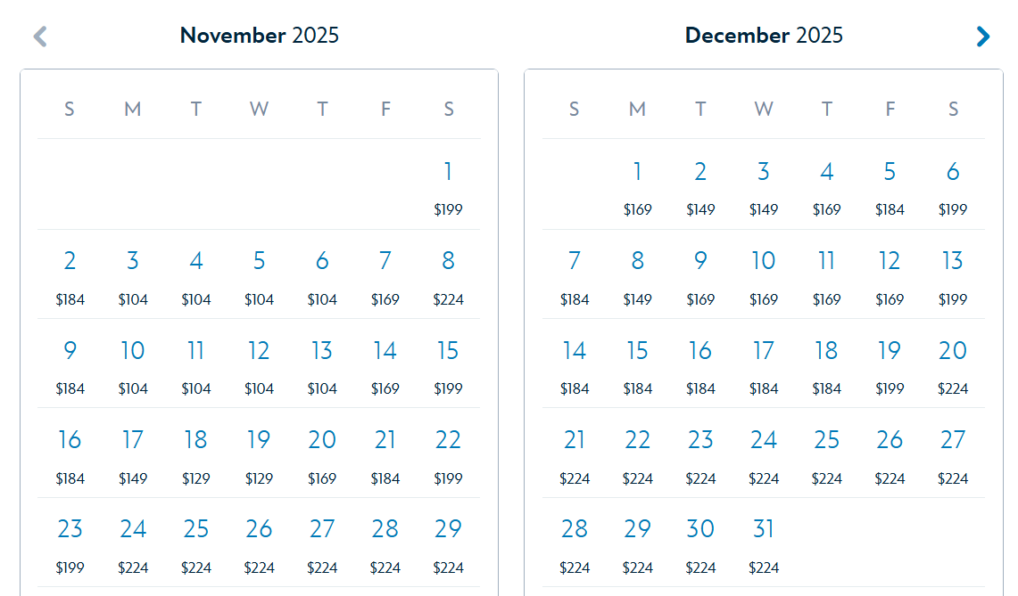
Complex Pricing · Case: Disneyland
Disneyland: 3rd-Degree Price Discrimination
Management 405 · Complex Pricing
28

Slide 29
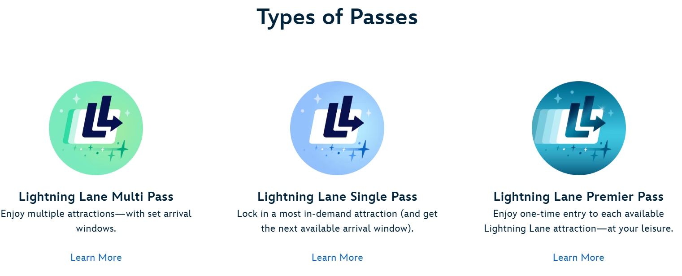
Complex Pricing · Case: Disneyland
Disneyland: Two-Part Tariff
Management 405 · Complex Pricing
29

Slide 30
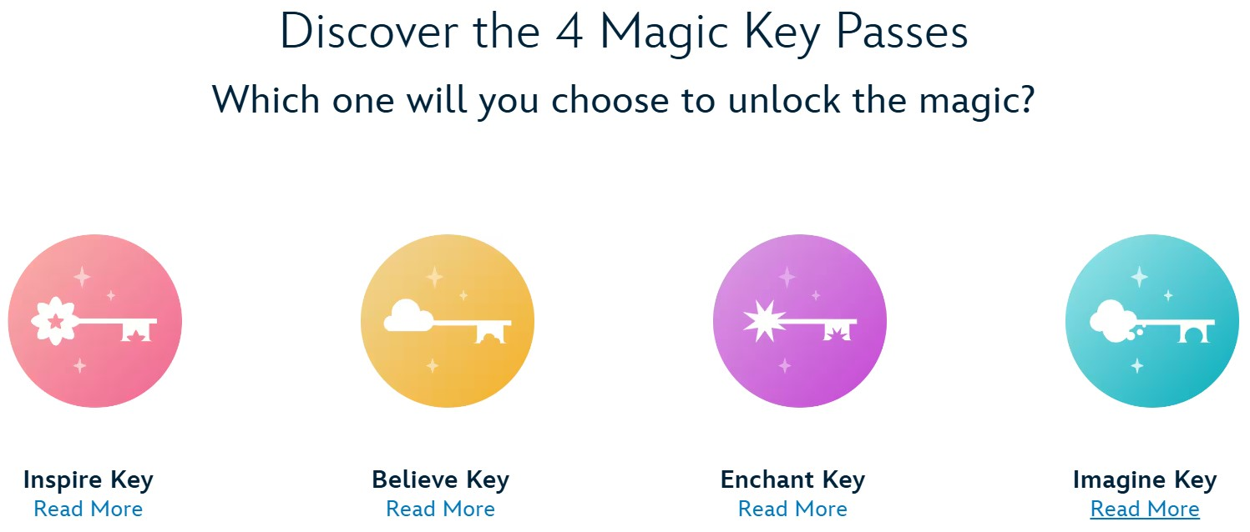
Complex Pricing · Case: Disneyland
Disneyland: Volume Pricing
Management 405 · Complex Pricing
30

